Slide 1
FREE vs. PAID:
Discoverability for Smaller
Mobile Games
Luke Schneider
Radiangames
Notes:
Hello everyone, I’m Luke Schneider
I’m supposed to tell you these things:
Silence your phones
And fill out the evaluations

Slide 2
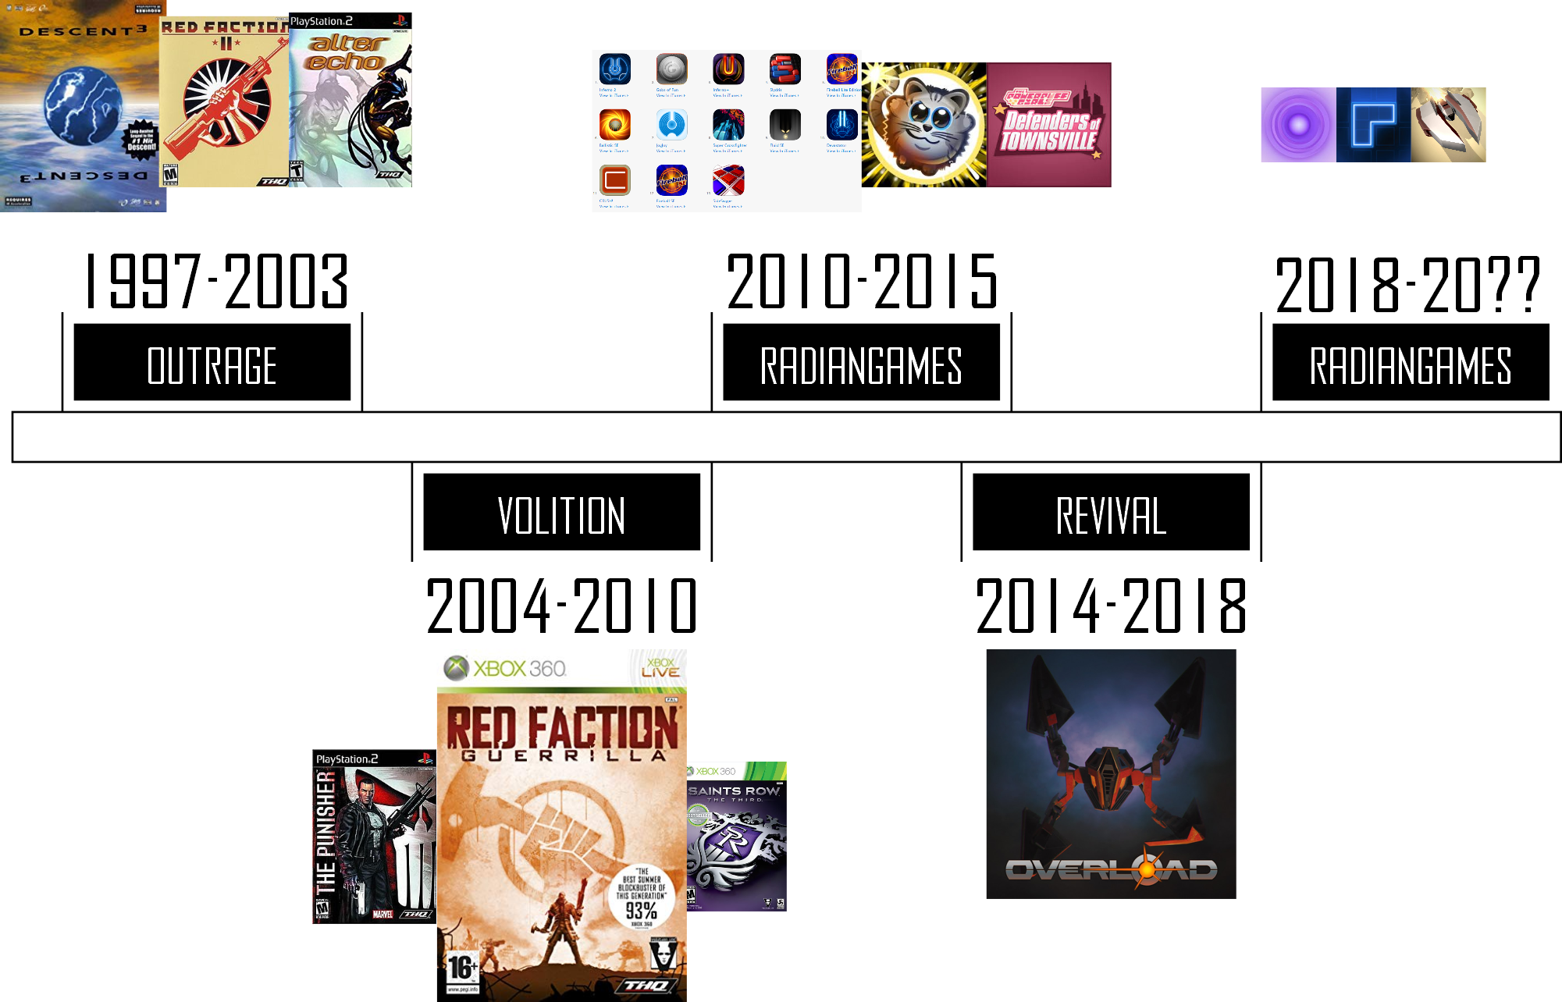
Notes:
This is a quick timeline of my history as a game developer
I’ve worked on small teams, large teams, and all by myself
I’ve created 17 mobile games as a solo developer, and most of those were self-published
A bunch of icons are a terrible way to show games, so here are a few of the games I’ll be talking about today...
--
Gap between Outrage and Volition: Worked on a small puzzle game for GBA and Xbox, sent lots of packets, talked to one publisher on the phone for 5 minutes
And came up with the name Radiangames
My first solo games were on Xbox Live Indie Games (7 games)
Published 5 of the games on PC
17 mobile games that have made some money (3 of those with publishers in some form)

Slide 3
BETTER CONTEXT
Video!
Notes:
[Video]

Slide 4

THE NEW RADIANGAMES?
Notes:
So… In the middle of last year, my work at Revival Productions was coming to an end
I had stopped Radiangames work for about 3 years to work on a spiritual successor to Descent
...I knew I wanted to go back to Radiangames full-time
But I wasn’t sure if I could still make a living doing paid games on mobile like I did in 2014…

Slide 5
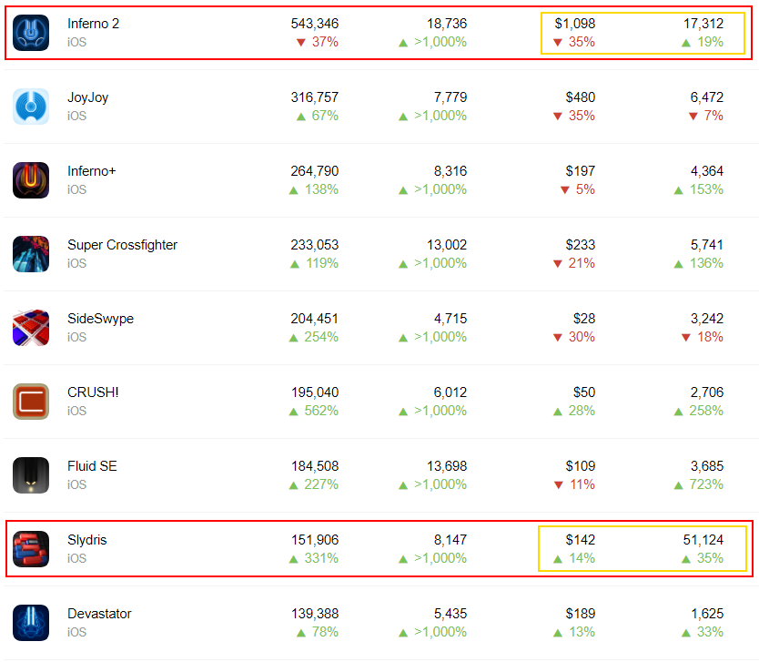
Notes:
When I was looking through my previous games’ analytics on the AppStore, something stood out...
The last column, sessions, is the one I want to highlight
Inferno 2, my best-selling game by large amount, is played 3 times LESS than Slydris
Slydris is an infinite puzzle game, similar to Tetris in a few ways
I wanted to make a sequel, and it seemed like a good idea to make Slydris 2 a free game
So I studied a lot of free games, and watched a LOT of videos about how to make Free to Play games
I’ll come back to how that worked out for Slydris 2 later...
...But let’s step back for a second, and ask why I chose mobile games over other platforms...

Slide 6
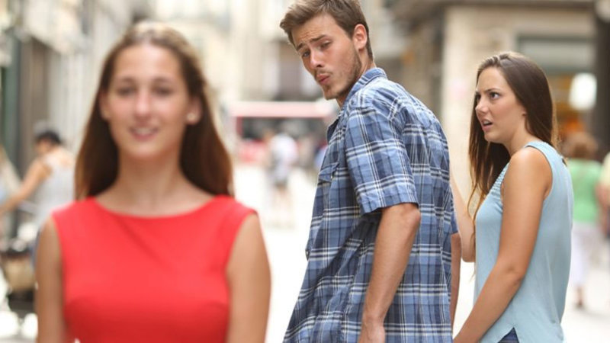




Notes:
Actually, the reason is simple:
TouchArcade and PocketGamer consistently cover my games, and Apple gives them minor features
I spent a long time working on Overload with the guys at Revival
It’s an awesome game but very few people know about it, and the sales reflect that
It reminded me how hard it is to get attention, and that I should take whatever attention I can get it
And just for reference, the mobile version of Inferno 2 has sold about 50x better than the PC version

Slide 7


DISCOVERABILITY
Worth spending on time (but I don’t):
Notes:
When people talk about Discoverability, they often mention reaching out to content creators and building a community
But not me
I don’t like to spend time talking to other people
I’m also not sure these things are worth it on a game that takes a month or two to make

Slide 8
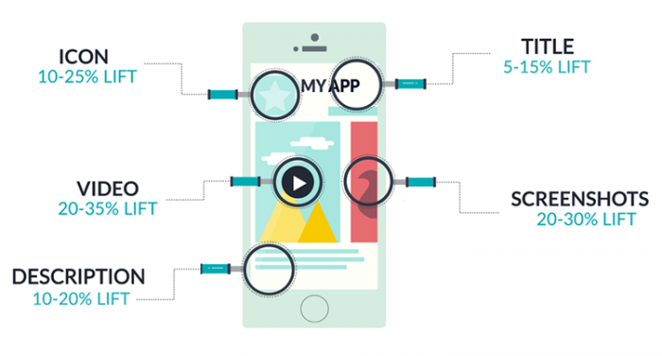
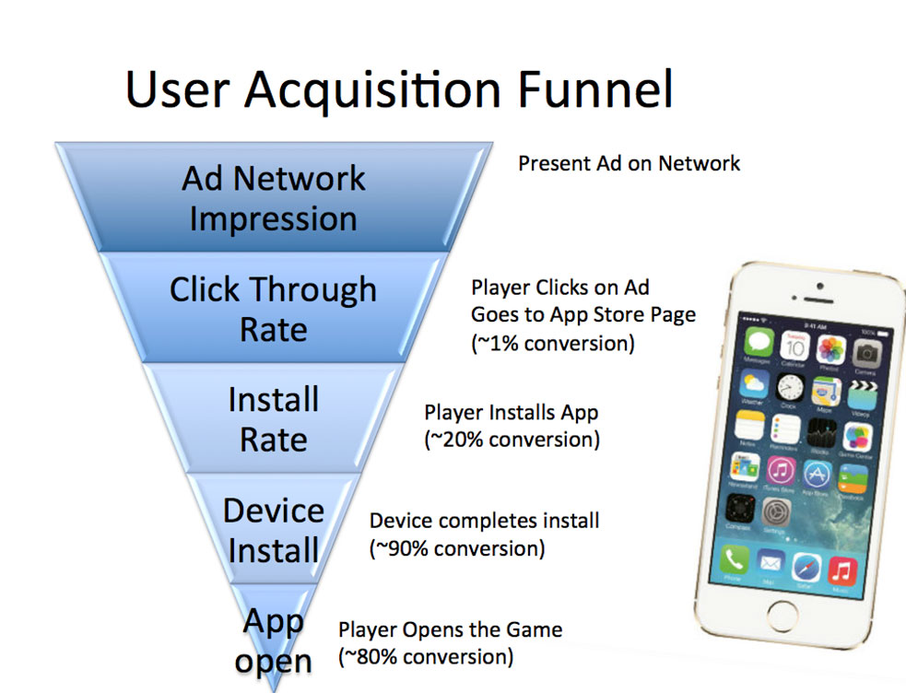
DISCOVERABILITY
Vital to free games:
Notes:
If you make free-to-play games, you need to make a good game, AND you need to do a lot more stuff on top
This is just the ASO side of things, and there’s a lot more I’ll cover later
I don’t want to spend a lot time doing anything, so I just do a a good first pass and don’t much spend time refining
But if you want to do well with free games, someone SHOULD be doing this stuff

Slide 9
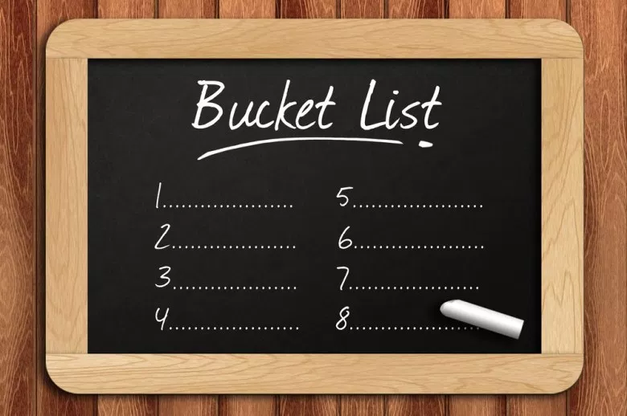
DISCOVERABILITY
Notes:
So if I don’t like spending time on major aspects of making my games successful, why am I up here?
My goal is not to make the most amount of money possible
It’s to make as many good games as I can before I die
So I’ve made that the core of my strategy for discoverability, and it’s worked, to some extent

Slide 10
DISCOVERABILITY
The Radiangames Cycle:
DEVELOP
SMALL GAME
ICON
SCREENSHOTS
TRAILER
RELEASE
REFINE
Notes:
First, I create small, quality titles quickly
I have lots of experience, and I’m able to focus, and I’m impatient
That’s the fun part of game development
Then I create all the stuff that I don’t enjoy doing, though I’ve started to enjoy making trailers
Then around launch, I email a dozen press people and do some social media posts
In the days after launch, I update the game to deal with feedback and refine it a bit, then move on as fast as possible

Slide 11
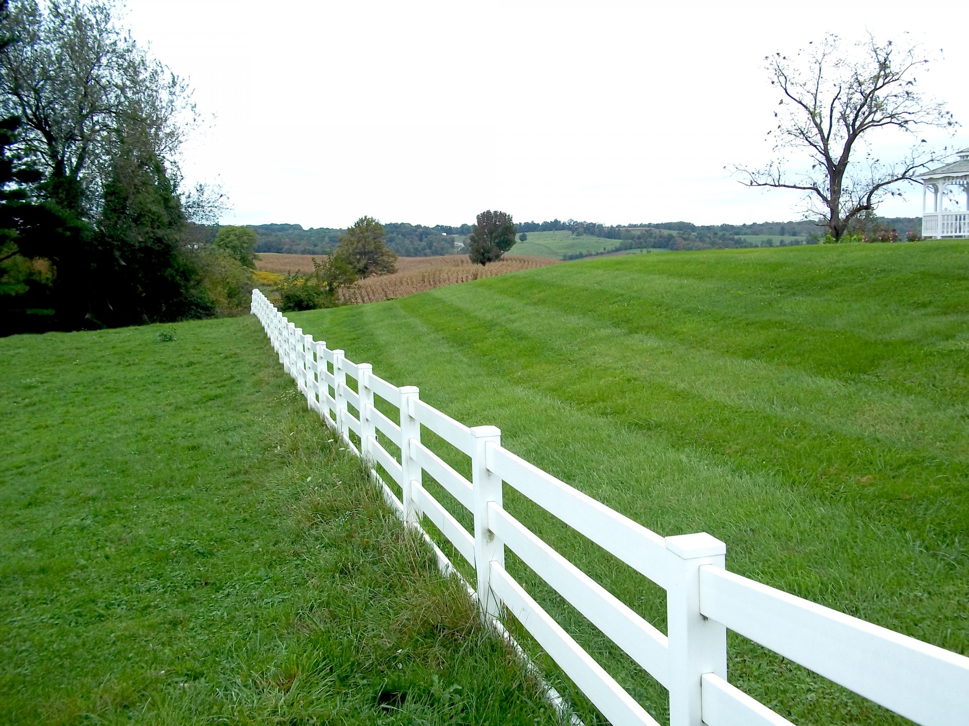
DISCOVERABILITY
Notes:
I’m usually excited to work on something new
In fact, I’ve probably worked on the next game for a week by the time the previous one is released
This cycle does NOT include contacting people at the AppStore or Google, but they obviously see my games on TA and PG
The only forums I use are TouchArcade’s
And I also do a weekly blog post, but it’s more for me than anyone else, to help sort out my thoughts

Slide 12
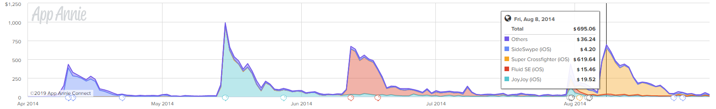
THE CYCLE OF 2014
Notes:
Here’s what happens when I get into a good cycle
This is a sales chart of my iPhone releases from 2014
It’s not very impressive, but keep in mind that that the Android versions were adding a decent multiplier on top
I didn’t realize it at the time, but I averaged 10,000 dollars a month between these 4 releases on those two platforms
And my next game was Inferno 2, which outsold all of these combined

Slide 13
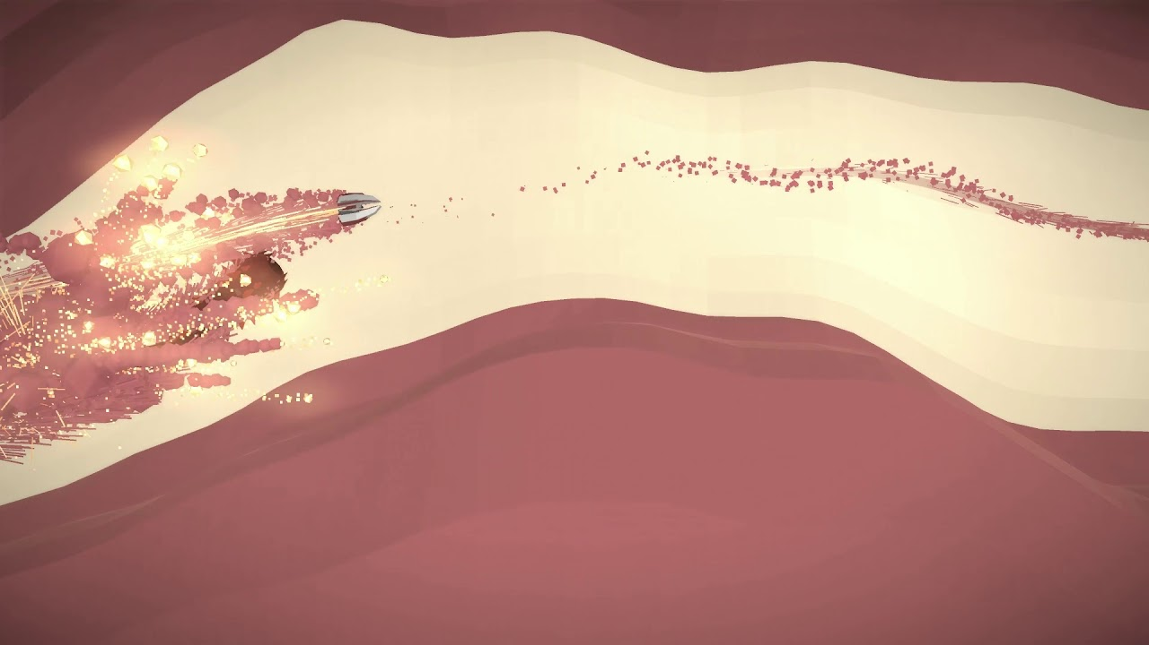
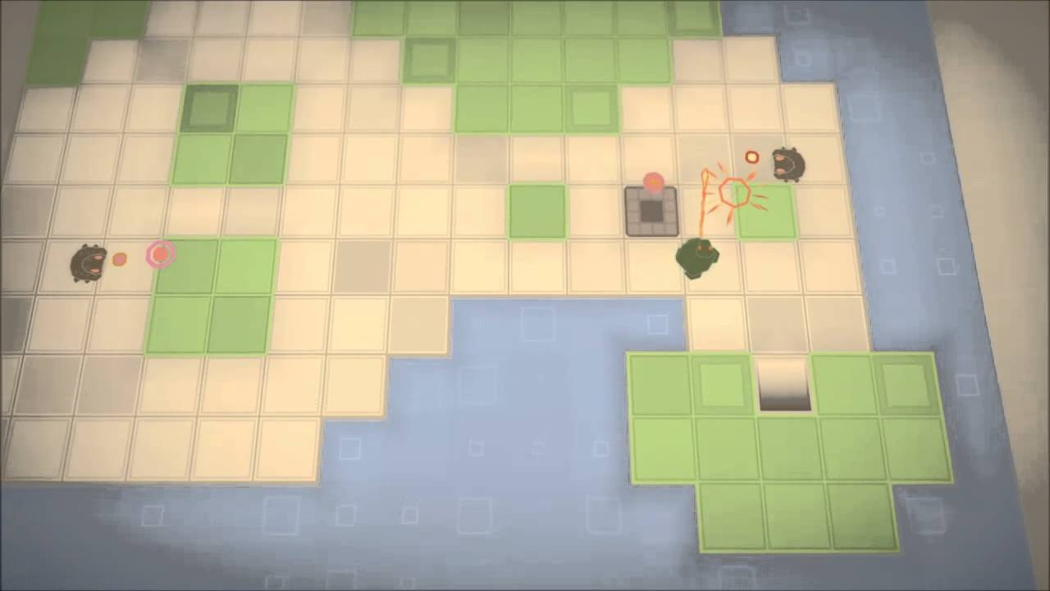
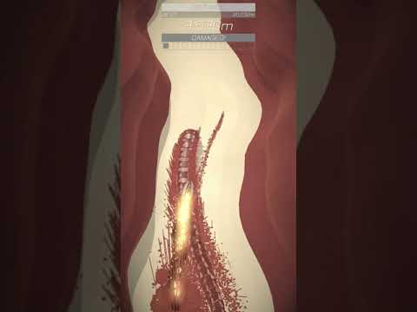
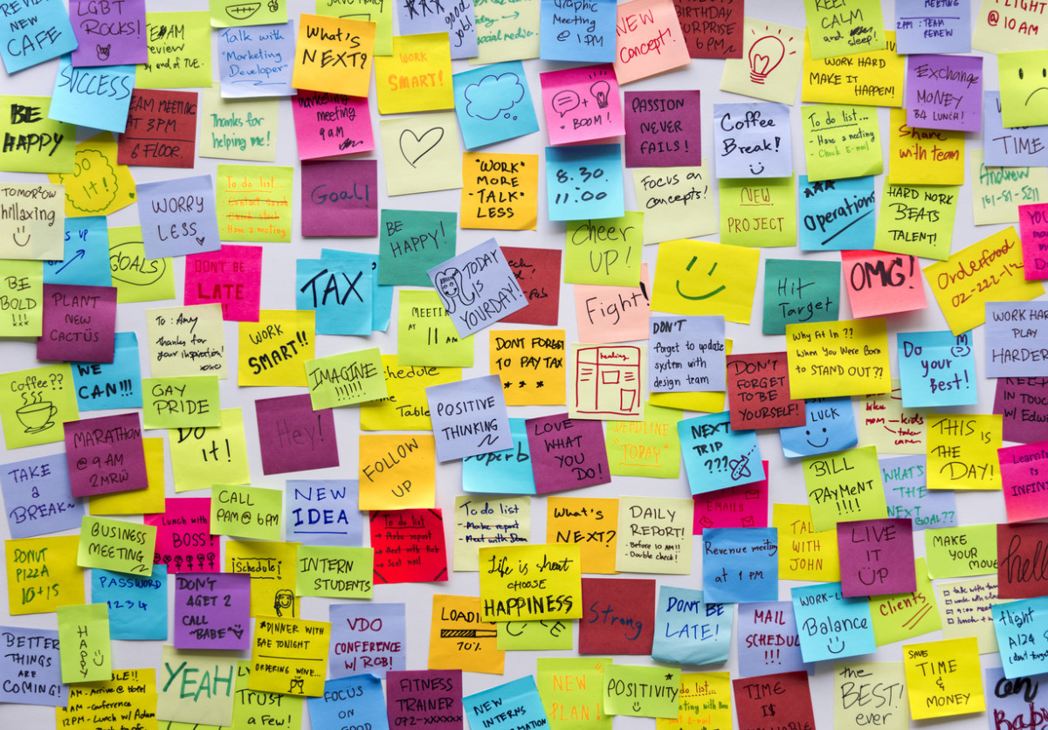
WAYS TO SCREW IT UP
Notes:
Stopping to do another “interesting” project is one way to screw up the cycle, but there are others:
Do your trailer too early, and you end up making a second one, like I did with Scorcher
Get too ambitious, and you end up with an alpha trailer, but nothing close to a finished game, like Gigatron
Or try to do too much at once, and it’s hard to actually finish anything
I can usually handle 2 projects at once, but beyond that I start to have trouble

Slide 14
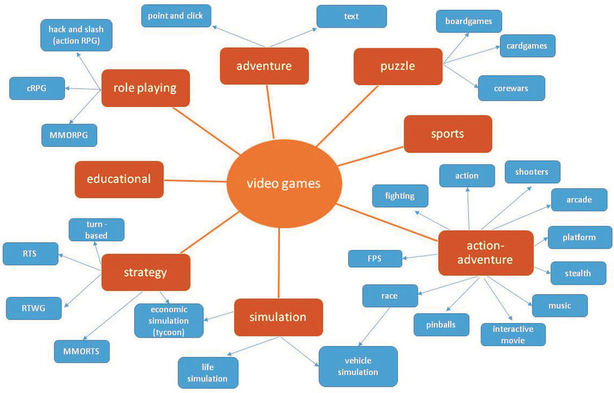
THE GENRE CAVEAT
Notes:
Keep in mind that I make arcady action and puzzle games
My deeper and more relaxed action games have sold better, but that usually involves more complexity and a longer dev cycle
Many other genres are better-suited to paid games for small developers, such as adventure games, role-playing games, and other story-based experiences
I’m not against doing larger games, but all my games have either been less than 2 months, or more than 10 months
Something in-between is probably the sweet spot for me, and I’ll try to aim for that in the future

Slide 15
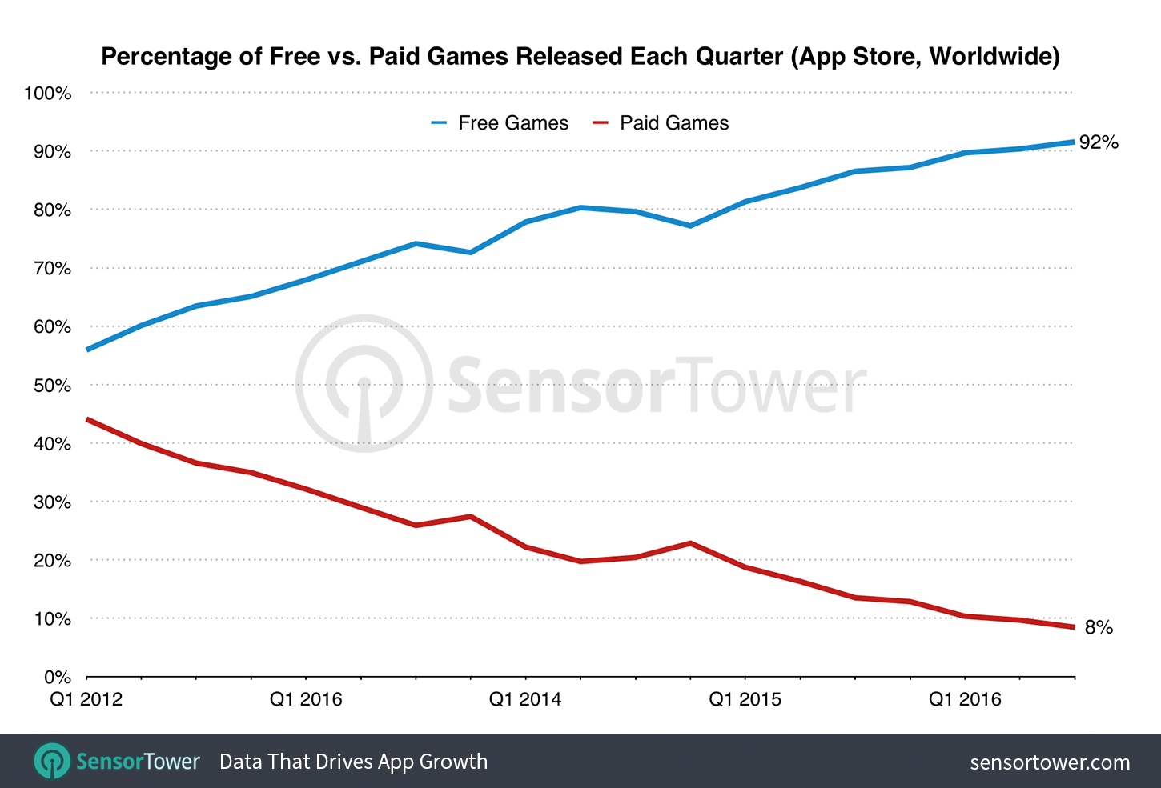
FREE VS. PAID
Notes:
Everyone knows free games are winning the battle for marketshare, and paid games are going extinct
This graph is from 3 year ago, and it’s hard to get much further apart than that
Very few developers are only making paid games on mobile, and the main reason...

Slide 16
R.I.P. PAID GAMES?
Notes:
These are screen-caps of today’s Top charts, with the Grossing Chart on the right
Minecraft is the top-selling paid game, and it’s ranked #62 in the grossing charts
The next game on the list is at #224
And this chart doesn’t measure ad revenue, just in-app purchases
There’s no question Paid Games are a bad idea if you’re trying to make a lot of money
If that’s your only goal, you should make free games, and I’ll get back to that
Let’s see how paid games have done for Radiangames over the past 7 years...

Slide 17

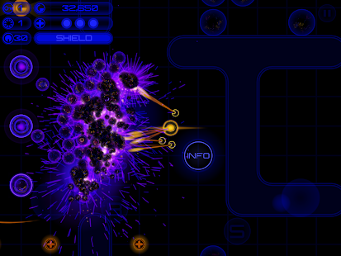
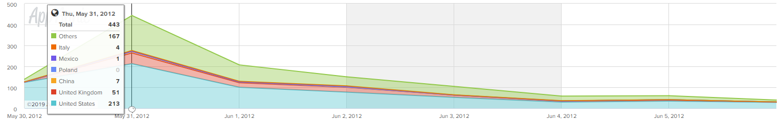
INFERNO+
Launched: May 2012
Revenue (5 weeks): $4,908
Peak Units: 213 (US) - Games #247
Notes:
Inferno+ is the 3rd title I launched as Radiangames, and my most successful of 2012
It got some press coverage, but no Apple features that I remember
Not a significant launch, but it’s had a pretty long tail because it’s a pretty good game

Slide 18
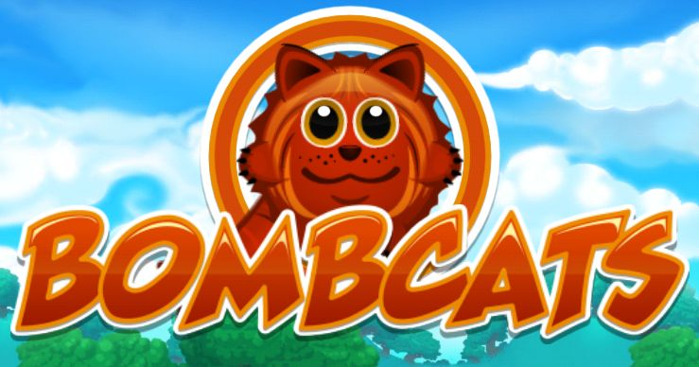
THE BIG ONE
Notes:
After moderate success converting 4 games to iOS, I spent about 10 months on a larger game called Bombcats
It was a huge... b.. Let’s say disaster, and the most stress I’ve felt as a developer
It’s still painful to talk about, to be honest, but just search my blog if you want to learn more
Let’s move on...

Slide 19

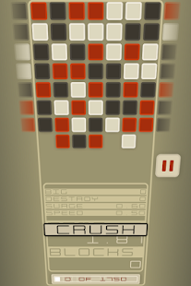
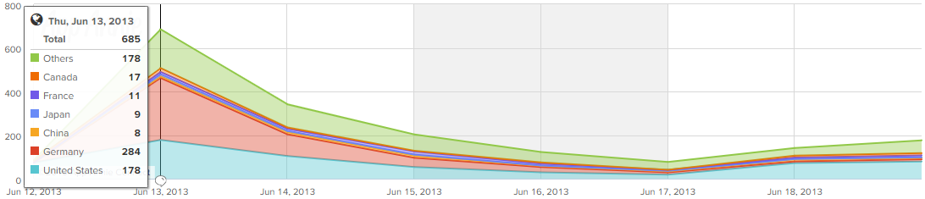
CRUSH
Launched: June 2013
Revenue (5 weeks): $2,395
Peak Units: 178 (US) - Games #230
Notes:
After Bombcats’ failure, CRUSH was a desperate attempt to get some money while I also worked on Android ports
It’s a pretty simple game, so I launched it at 99 cents
This was my 5th solo release, and I still couldn’t break the Top 200 on the paid game sales charts
The Android ports ended up doing pretty well, and I signed a contract to work on a game with Cartoon Network, so Radiangames was able to continue

Slide 20

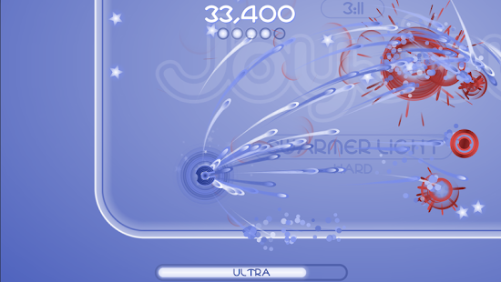
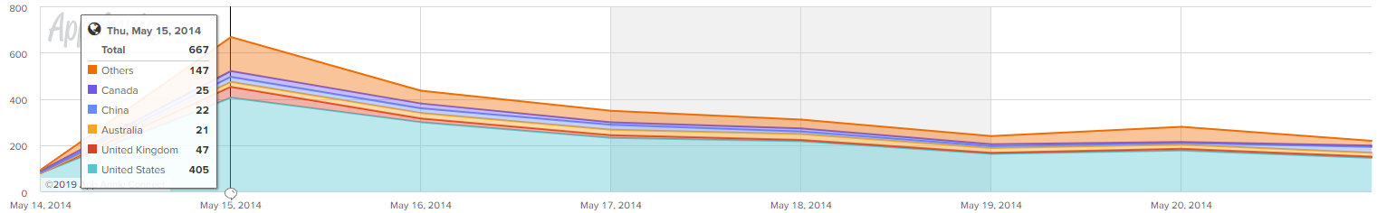
JOYJOY
Launched: May 2014
Revenue (5 weeks): $5,325
Peak Units: 405 (US) - Games #188
Notes:
After the Powerpuff Girls game, which took around 10 months, I went back to smaller games
JoyJoy was the 2nd release in 2014, and probably the start of the “golden era” of Radiangames releases
It got the usual amount of coverage, AND some good featuring by Apple
It had a solid launch week, and one of my games finally broke the Top 200

Slide 21

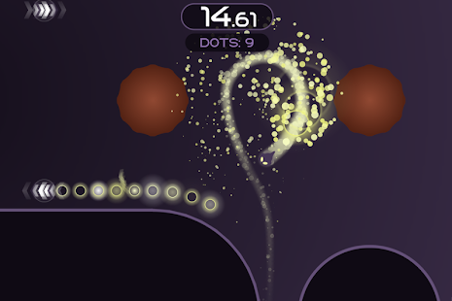
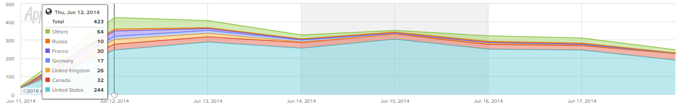
FLUID SE
Launched: June 2014
Revenue (5 weeks): $5,015
Peak Units: 244 (US) - Games #115
Notes:
Fluid was launched a month after JoyJoy, with pretty consistent results
June had fewer game releases, so even though it sold less in the US, Fluid got much higher on the charts than JoyJoy

Slide 22

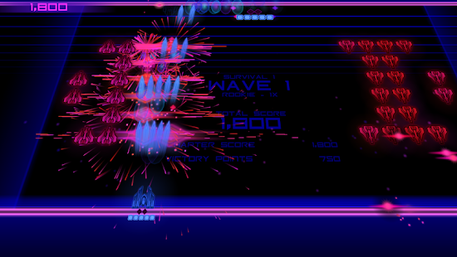
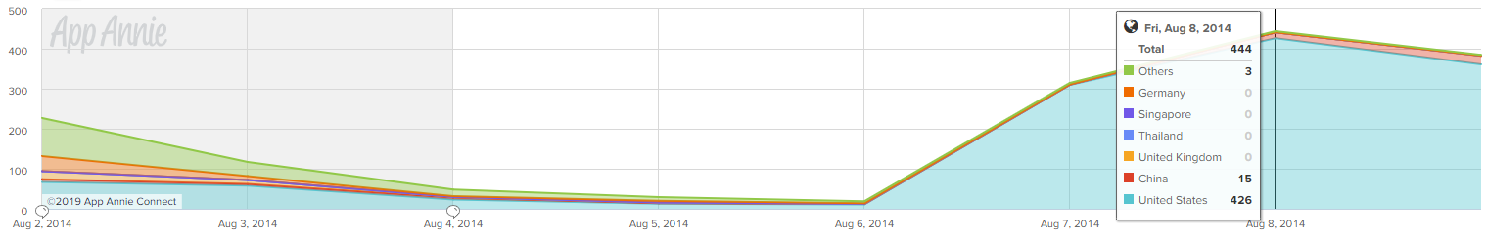
SUPER
CROSSFIGHTER
Launched: August 2014
Revenue (5 weeks): $4,820
Peak Units: 426 (US) - Games #74
Notes:
Super Crossfighter also got good coverage, even though it was a remaster of a 3 year old game
The sales spike is late because it was featured by Apple the week after it launched
It had my best US sales day so far, and it broke the Top 100

Slide 23

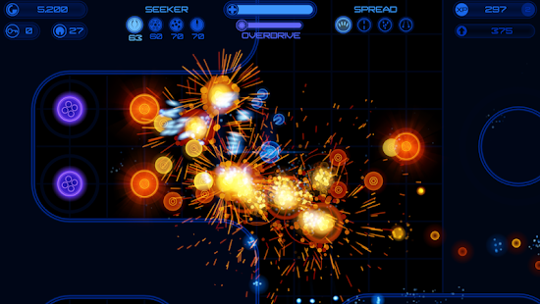
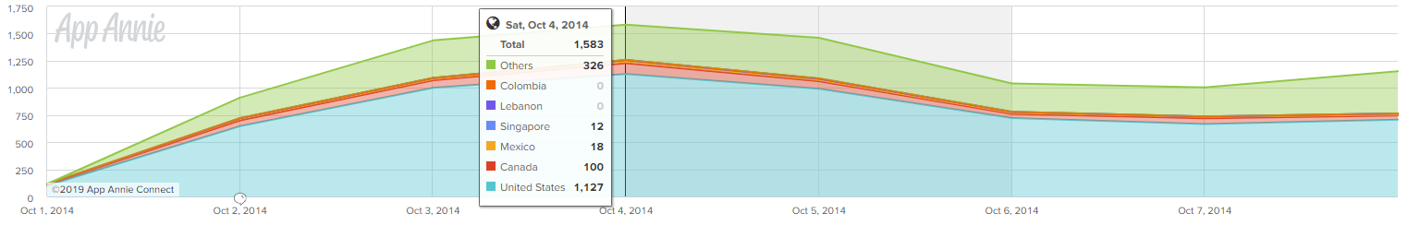
INFERNO 2
Launched: October 2014
Revenue (5 weeks): $33,168
Peak Units: 1,127 (US) - Games #44
Notes:
Then came Inferno 2, and I finally had my first “hit” game
It got the #3 slot on the New Games list, the highest of all my games
Notice that it took over 1,000 sales in a day to reach the #44 ranking

Slide 24

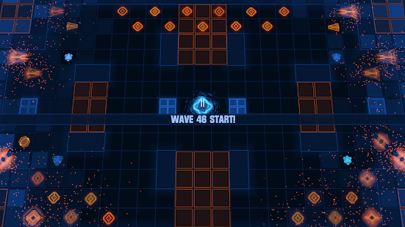
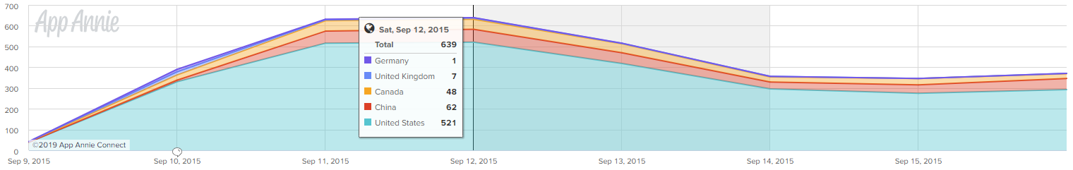
DEVASTATOR
Launched: September 2015
Revenue (5 weeks): $5,059
Peak Units: 521 (US) - Games #46
Notes:
In September of the next year, I launched Devastator
It got a good feature by Apple, though not quite as good as Inferno 2
Notice that it reached almost the same Paid Games sales rank, with under half the sales
We can start the see the effect of fewer paid games being released
Also, it took 5 weeks to make… so why did Devastator release 11 months after Inferno 2?

Slide 25
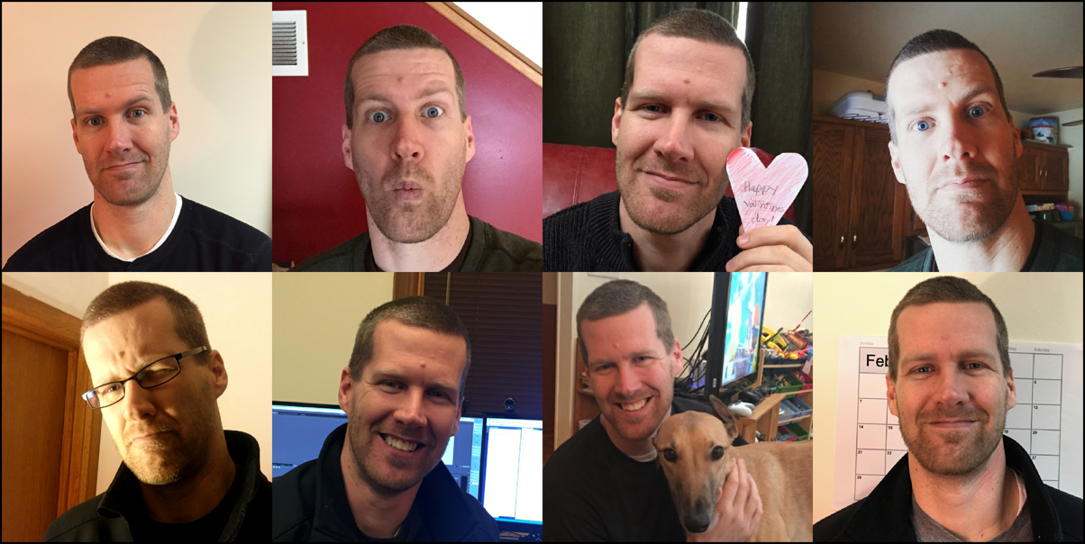
INTERMISSION:
OVERLOAD
Notes:
I had started working on Overload before I knew how successful Inferno 2 would be
The next year after Inferno 2 was pretty messy in terms of development, and it was probably the least productive since I started Radiangames
After Devastator, Overload development resumed with more people, and Revival decided to do a Kickstarter
This was 2 years AFTER Kickstarter had peaked
These pics are from the Overload Kickstarter campaign, the 2nd most stressful thing I’ve gone through as a developer
Our Kickstarter made it with 2 hours remaining, but it was definitely not worth because of all the promises we made
On the positive side, Descent fans love the game
And I learned a lot about Unity and became a better programmer

Slide 26
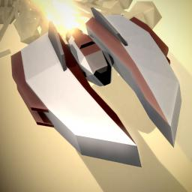
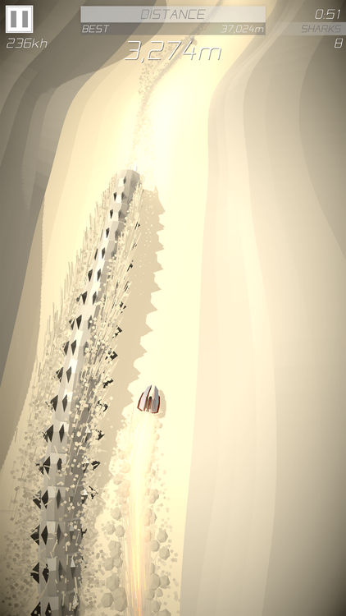
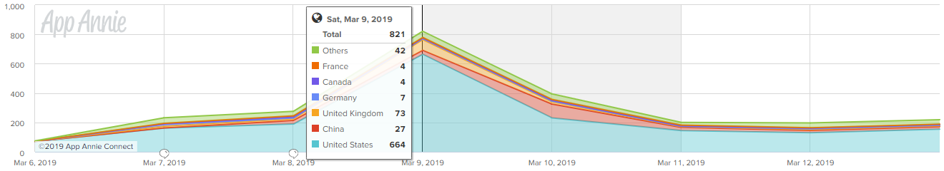
SCORCHER
Launched: March 2019
Revenue (5 weeks): $7,000-$8,000? ($5,800 so far)
Peak Units: 664 (US) - Games #25
Notes:
Getting back to paid games, we now fast forward to my first paid release since Devastator
Scorcher released 2 weeks ago... and I have to admit I was a bit worried it wouldn’t be out in time for this GDC talk
It looks like a normal launch sales curve, except for a bigger-than-usual Saturday spike thanks to an extra feature on that day
It’s doing about as well as I expected
The game stands out visually, but it’s also score-focused, and those don’t sell as well in my experience
It has significantly fewer sales than Inferno 2, but much a better chart ranking

Slide 27
SALES PEAK VS. RANK
2012
213 downloads = #247
96 downloads = #502
2013
178 downloads = #230
72 downloads = #543
2014
1,127 downloads = #44
651 downloads = #59
202 downloads = #165
2015
516 downloads = #46
292 downloads = #59
187 downloads = #104
2016
236 downloads = #77
90 downloads = #378
2019
664 downloads = #25
189 downloads = #79
Notes:
Let’s look back at a bunch of numbers to see how many downloads it takes to get to certain slots in the Top Paid charts
Look at the early years vs. 2019, and you can see it takes a lot fewer downloads to get into the top of the paid game charts

Slide 28
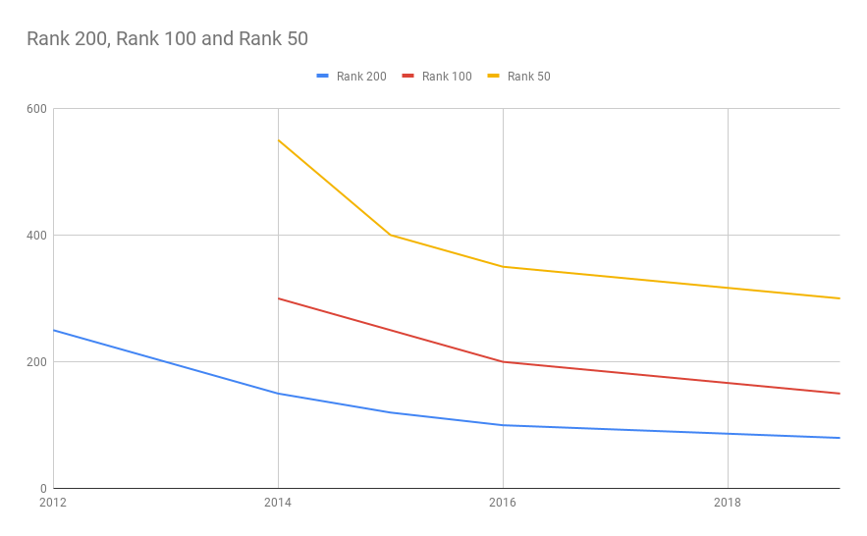
APPROXIMATE PAID SALES
TO REACH RANK 50/100/200
Notes:
It used to take over 200 downloads to get into Top 200 Games in 2013, and now 200 downloads gets you in the Top 80
The top yellow line shows how many downloads you need to get to reach the Top 50
So why are top selling games selling less?

Slide 29
TWO REASONS
DEFINITELY
FEWER Paid Games
MAYBE
Fewer Paying Players?
Notes:
Everyone is making free games, and not many are making paid ones
Because there are more free games, and many of them are good, many people are less willing to pay
To be honest, it’s hard to judge based on one game released this year, and I need to release more to make any definite conclusions
But I don’t think paid games are dead, just neglected
Now let’s take a look at a comparable free game, which released 4 months ago...

Slide 30

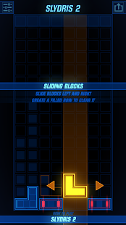
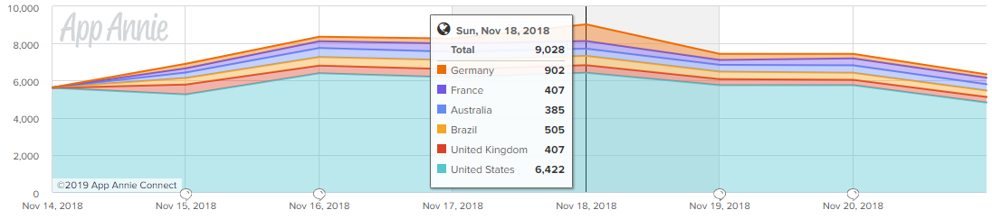
SLYDRIS 2
Launched: November 2018
Revenue (5 weeks): $2,154 (IAP) + $4,556 (Ads)
Peak Units: 6,422 (US) - Free Games #207
Notes:
This is Slydris 2’s launch, which got a similar level of coverage and featuring as Scorcher
The overall revenue is actually pretty similar to Scorcher for the first 5 weeks, just a bit more smoothed out
Notice that it was getting around 6,000 downloads a day, but never broke the Top 200 in Free Games

Slide 31

FREE VS. PAID:
APPLE FEATURE COMPARISON
(#7 EDITION)
Notes:
When I said the games had a similar level of featuring, I was under-selling it
Scorcher and Slydris 2 had the same feature slot on launch in the US
#7 in the New Games We Love list
Not sure if Apple meant to give them the same slot, but it sure makes for a nice comparison
The games are different, but based on experience, I’d expect reasonably similar sales between the two
Let’s compare more directly...

Slide 32
THE GOLDEN RATIO
Slydris 2
#7 Slot - FREE
46,180
US Rank #207
FREE:PAID
20:1
Scorcher ($2.99)
#7 Slot - PAID
2,325
US Rank #25
Notes:
These are the first week downloads in the US ONLY, with the same feature slot
Slydris 2 released at a better time of year, but Scorcher had a bonus feature
I’m not sure if this ratio is accurate, but it feels about right to me
For lower priced games, the ratio will be a bit closer
The important thing, aside from the ratio, is where the games ended up on the charts
There are just a lot more free games getting tons of downloads

Slide 33
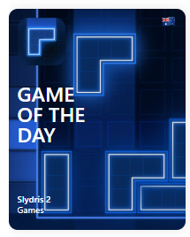
QUALITY MATTERS
Featured in US - January 6th, 2019
31,084 downloads in US - Free Games #99
Featured in other countries - February 21st, 2019
62,691 downloads WORLDWIDE (9,219 in Russia)
Featured in China - March 3rd, 2019
42,662 downloads in China - Free Games #19
Notes:
Long-term, Slydris 2 has continued to do pretty well
For people who figure it out, it’s a very satisfying and enjoyable puzzle game
It was my first game to get a significant Apple Feature beyond a good launch slot
It got Game of the Day in the US in January, a bunch of other countries in February, and China in March
It was like getting 3 extra launches for the game
The best revenue day was from the China feature, mostly due to ads

Slide 34
SLYDRIS 2 STAT DUMP
Total downloads: 339,654 (Thanks Apple!)
IAP total: $6,425
Ads total: $16,323
CERTIFICATE OF INEPTITUDE
Day 1 Retention: 29.9%
Day 7 Retention: 14.0%
ARPDAU: $0.02
Notes:
Let’s check out the totals for Slydris 2 so far
Given the quality of the game and downloads, these revenue numbers seem pretty low
The reason is the retention and ad revenue numbers aren’t very good
I’m happy with the downloads and overall results, but I’ve been lucky
And those numbers could definitely be worse...

Slide 35

SAD PIVOTOL STATS
Total downloads: 73,425 (most in the 1st week)
IAP total: $276
Ads total: $1,412
LOOK AWAY! SERIOUSLY!
Day 1 Retention: 14.8%
Day 7 Retention: 5.2%
ARPDAU: $0.01 (OUCH!)
Notes:
These are the same stats for Pivotol, which launched a month before Slydris 2
It was the TouchArcade Game of the Week, so it’s not a bad game
And it was featured in the New Games We Love list, and I updated it a number of times
But it was just a little too hard for many people to figure out, and not quite as good as Slydris 2
This is what happens when you don’t really know how to make a free game
If it had been paid, I’d estimate it would have made 3x as much, if not more

Slide 36
FREE GAME MENTALITY
(THE EASY STUFF)
EXTREME focus on ease of use
Expect to make frequent UPDATES
Iteration and refinement
Notes:
Making free games is harder than paid games in a few ways
You have to be more hardcore about ease of use
And refining the UI flow
And keeping things simple
This is the easy stuff, that as a developer you can handle
It requires a shift in your mentality, but it’s not painful

Slide 37
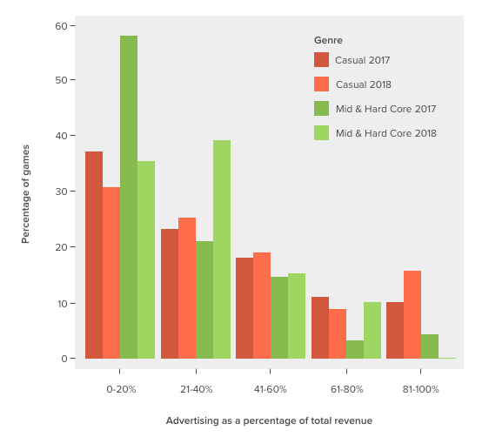
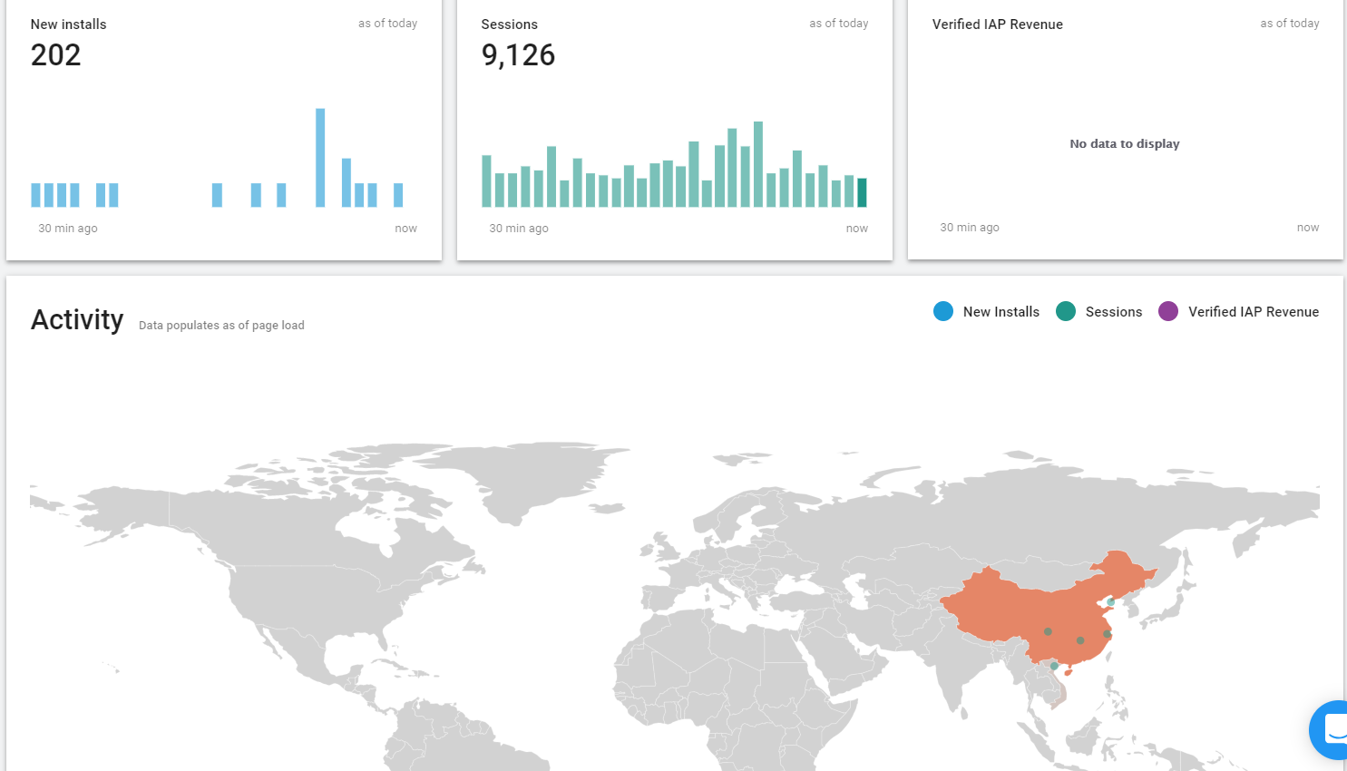
FREE GAME MENTALITY
(THE HARD STUFF)
Notes:
Now we’re getting to the more painful stuff
Doing a free game means you have to think about ads, or In-App Purchases, or both
You’ll feel more constraints on the genre, and the expected complexity
The games’ systems will be warped to fit the need to retain users and generate revenue
Ad-based games need to be simple, and in-app purchase games deep and content-heavy
You also have to be obsessive with your stat-checking
This page over here, it updates in realtime, every install and start of the game flashing on the map, and it’s not good for your sanity

Slide 38




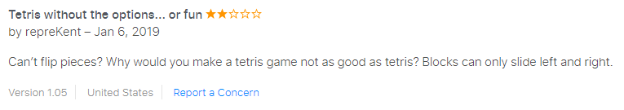
FREE GAME MENTALITY
(THE HARD STUFF)
Notes:
After launch, you’ll get emailed by lots of ad companies offering to boost your revenue
Do you use multiple companies, or just stick with one for simplicity?
How much do you negotiate, how much time is required to set all this up?
Then there are the reviews...
SOME Negative reviews provide critical info about a bug or issue
But many others are not as fun to read, but they might be useful, so you have to suck it up
And all the ASO and UA stuff from before should be done too
Making free games is overwhelming, and I have a simple recommendation if you want to do them...

Slide 39
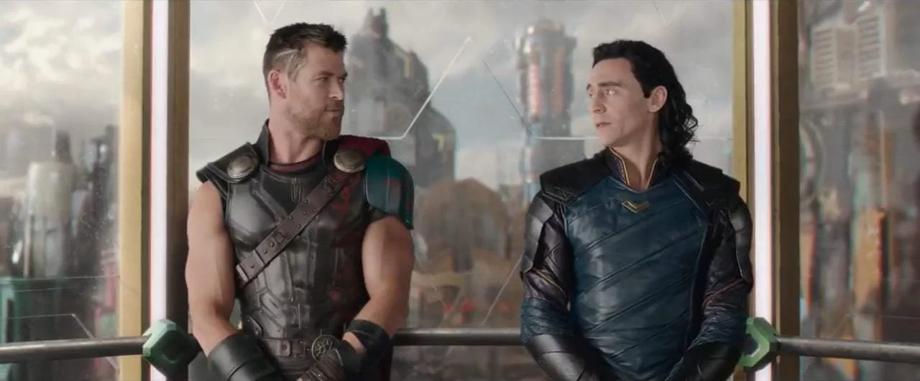
GET HELP!
Notes:
If you don’t enjoy obsessing over optimization and stats, get someone to help you
It could be a partner, a publisher, a co-developer, or a consultant
If you’re doing free games, I’d almost say this is a requirement
Let someone else who knows what they’re doing handle the painful stuff
You’ll have to share some of the money, but there will probably be a lot more of it

Slide 40

FREE VS. PAID IN 2019
(FOR SMALL DEVELOPERS)
Notes:
This is what it feels like to make a paid game in 2019
It doesn’t mean you shouldn’t do it
But go into it with proper expectations
There are still some players who will love you and prefer paid games
And you’ll probably be able to make more of them, if that’s important to you

Slide 41
FREE VS. PAID IN 2019
(FOR SMALL DEVELOPERS)
?
Notes:
Slydris 2 and Scorcher had similar featuring and revenue numbers in the first few weeks
It’s still too early to tell what the long-term sales will be, and Slydris 2 got lots of help from Apple
But working on Scorcher was more enjoyable, and the launch less stressful
And I would have enjoyed working on Slydris 2 more if it were paid and made the same amount of money
I don’t like that nagging feeling that I need to keep working on a game
I like finishing things, and feeling good about finishing it, and moving on

Slide 42
FINAL REMINDERS
Paid Games are dormant, not dead
I’m not doing free games well
Notes:
If you’re doing paid games, you probably need to get an Apple Feature to be successful, that’s not anything new
You’ll also have a lower cap on the revenue you make, but you might enjoy working on the games more
There are fewer paid games, but I don’t think good ones are necessarily selling less
There are just a lot less of them
On the other hand, I studied free games for many months before doing Pivotol and Slydris 2, and I still sucked at it
It takes a certain mentality to do free games, and it’s hard to do by yourself
Get an expert to help you, and you’ll be less stressed, and probably make a lot more money

Slide 43
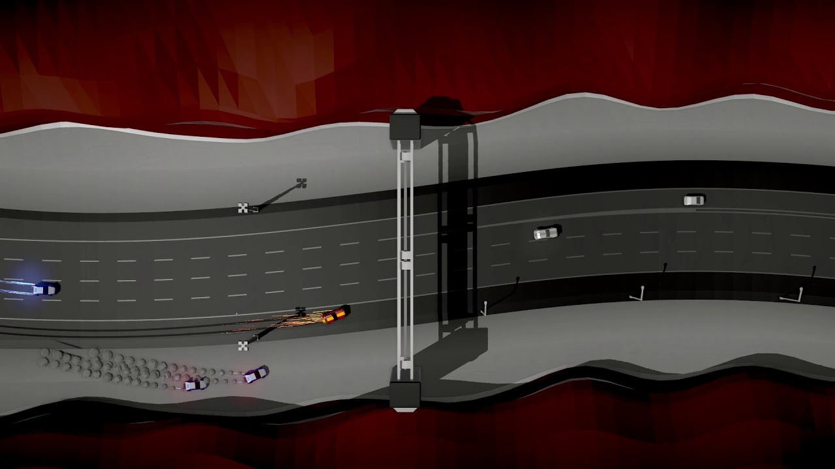
EARLY TRAILERS
Notes:
Before I end, I have a couple more quick slides…
Earlier I recommended not doing an early trailer
BUT Sometimes it works out, if you have the right game and trailer
I have around 2,000 followers on Twitter, but a tweet with the trailer for Speed Demons got over 12,000 views in the first week
It was my most liked and retweeted thing of all time
And it opened up new opportunities for Radiangames
But it was a risk spending that much time on a trailer that early in development

Slide 44
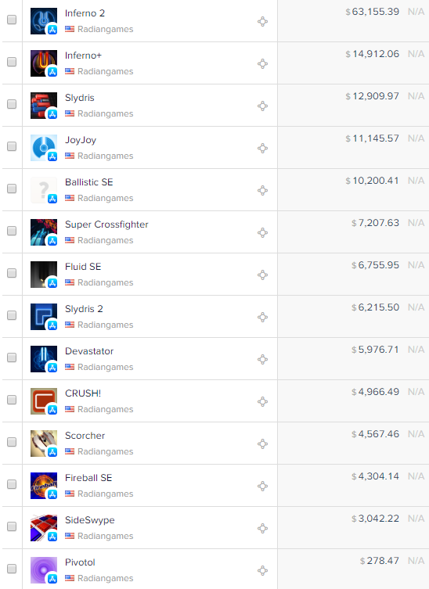
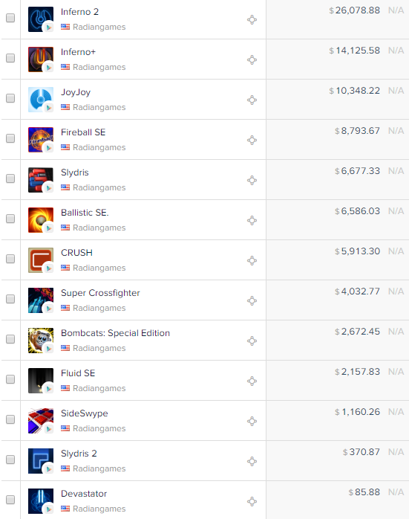
Notes:
Let’s take a look at some total sales numbers...
These charts are a few days old, so the Scorcher sales are a little off
And the free games show in-app-purchase revenue only
I don’t know what happened with Google Play, but Google has done almost nothing for Radiangames this year
Regardless, my better games have better long-term sales, which is encouraging

Slide 45
FIRST YEAR RATIO
GAME
Inferno+
CRUSH
JoyJoy
Fluid SE
Inferno 2
Devastator
WEEK 1
$2,450
$1,281
$3,664
$3,422
$18,037
$4,653
YEAR 1
$10,376
$4,345
$8,644
$6,310
$56,858
$5,645
RATIO
1:4.2
1:3.4
1:2.4
1:1.8
1:3.2
1:1.2
Notes:
A little while back, someone put together a comparison of 1st week vs. 1st year sales for a bunch of Steam games
Simon from GDC asked me to do the same for my games, so here are 6 games in order of release
The ratios are lower than I expected, though the revenue numbers aren’t
The biggest 2 factors in what affects the ratio:
Perceived game quality and style of game leads to better long-term sales
And the games with the lower ratios had usually had better features their first week

Slide 46
QUESTIONS?
luke@radiangames.com
@Radiangames (Twitter)
Notes:
And that’s it
If you have questions...

